Slide 1


BIOCYBERNETIC LOOP ENGINE
Manual to integrate videogames developed in Unity3D
Notes:
The Biocybernetic Loop Engine (BL Engine) is a software tool that aids the integration of physiological intelligence in games and interactive applications. The BL Engine has a native support to collect cardiac related signals from several devices. Moreover, the Emocam Panel and the Reh@Panel have been integrated to include the use of facial emotions and brain signals from comercial-grade BCI devices.

Slide 2
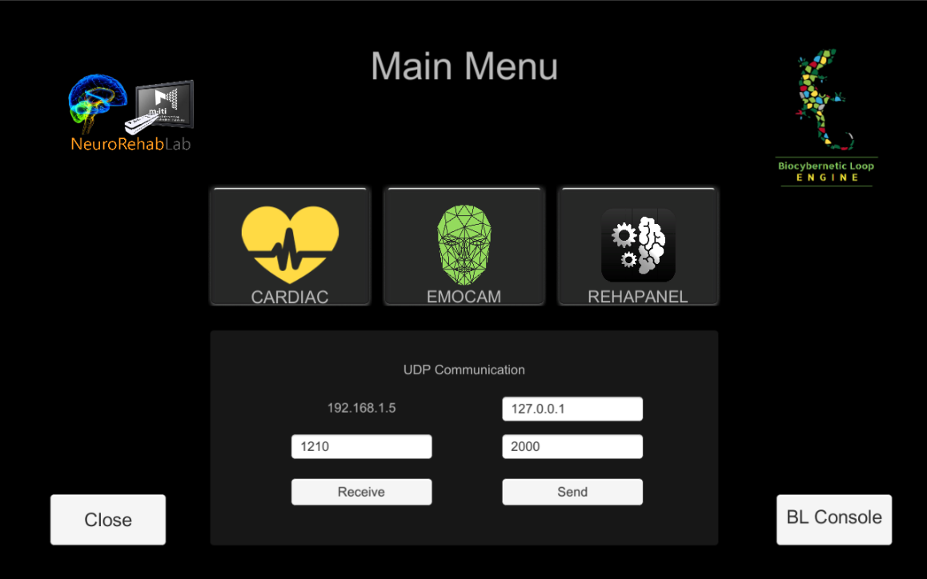
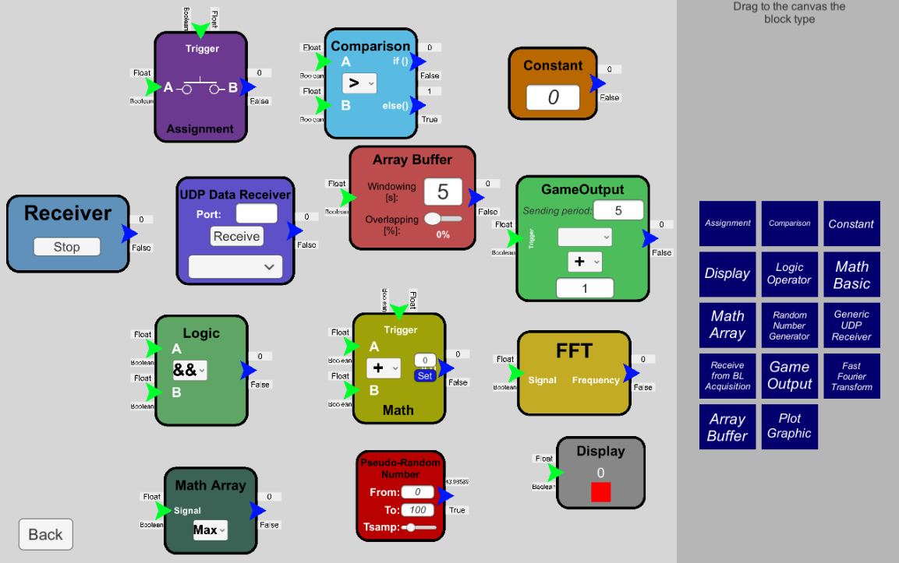


BIOCYBERNETIC LOOP ENGINE COMPONENTS
Main Menu
Select the signal(s) for the acquisition. Configurate UDP client/server
2. Biocybernetic Console
Create the adaptive rule based on a visual programming language
3. Game Scripts
C# scripts to add in the Unity game to send/receive variables

Slide 3
STEP 1: SELECT A SIGNAL AND CONFIGURE THE UDP
Cardiac Panel:
Includes ECG, PPG and computed Heart rate data from several devices
2. EmoCam Panel:
Includes the Affectiva SDK to recognize Emotions from webcams
3. REH@PANEL (Link)
Includes an external application that streams data from many sensors

Slide 4
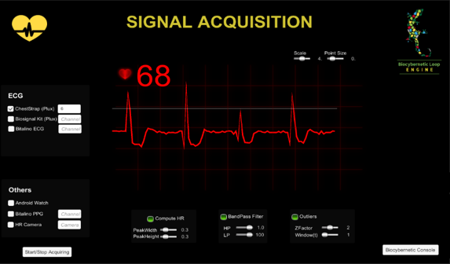
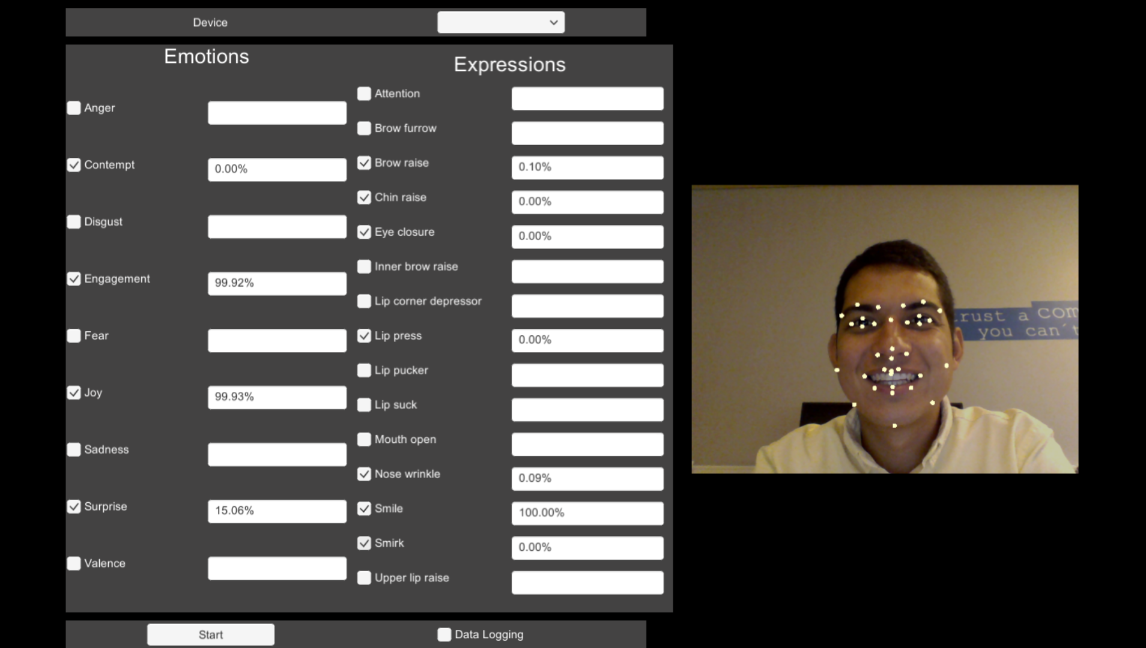
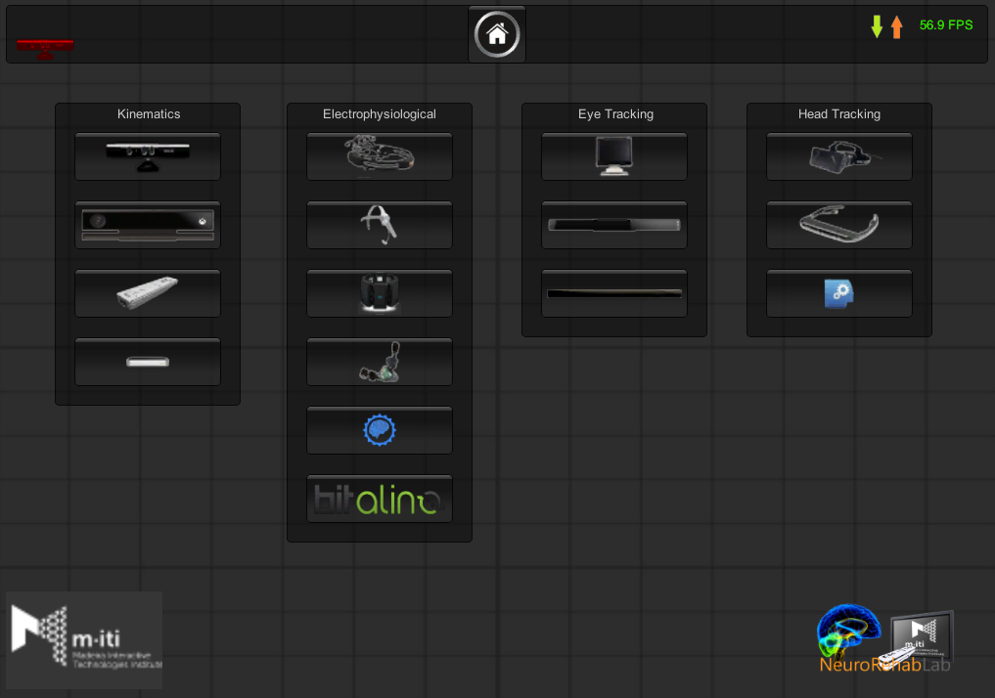
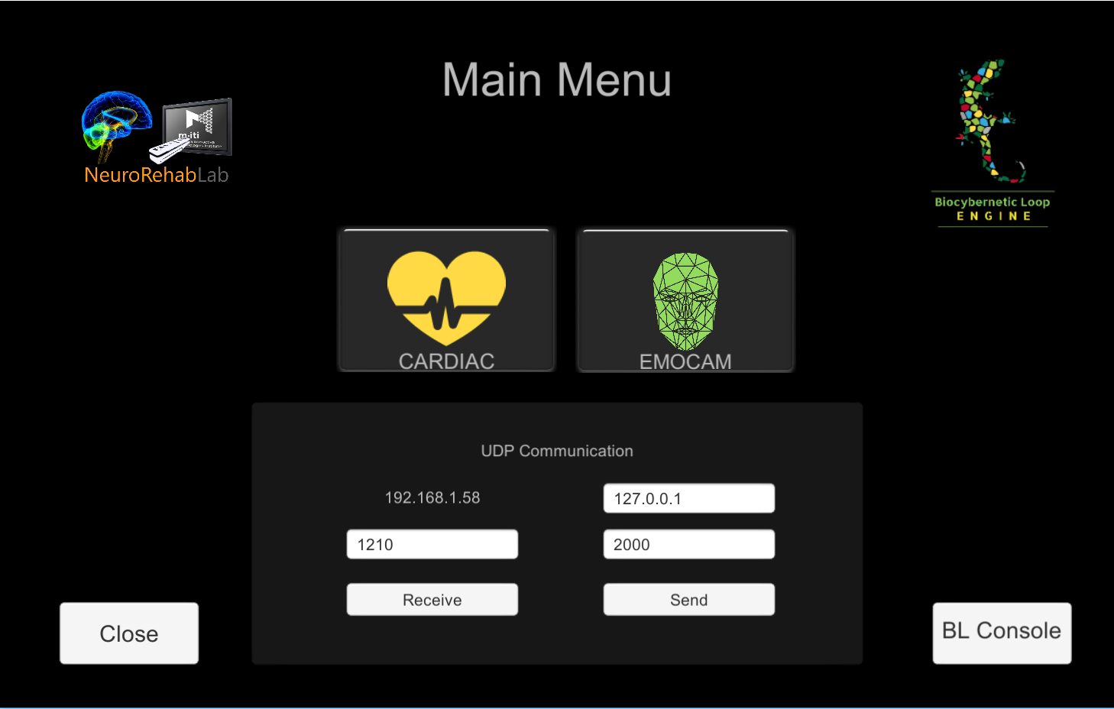
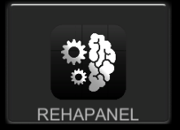
STEP 1: SELECT A SIGNAL AND CONFIGURE THE UDP
Cardiac (Heart Rate)
EmoCam (Emotions & Expressions)
Reh@Panel (More sensors)
Processed HR data (BPM)
(Heart Rate)
Emotion Probability (%)
(Anger, Contempt, Disgust, Engagement, Fear, Joy, Sadness, Surprise)
Other sensor data
(Kinematics, Brain Computer Interface, EMG, Eye Tracking)

Slide 5
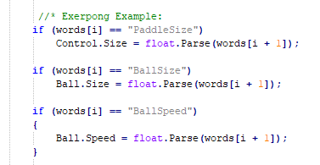
STEP 2: INCLUDE THE DATA SENDER/RECEIVER SCRIPTS IN YOUR GAME (Unity Package)
Used to send the Game Variables from the Videogame to the BL Engine
Used to receive in the BL Engine the Game Variables from the Videogame.
Invoke this in your game_difficulty script!
Identify previously your GameVariable(s)
Send the game variables that you want to modify following this protocol:
GameVariable_VariableName, VariableType, CurrentValue,MinValue, MaxValue

Slide 6
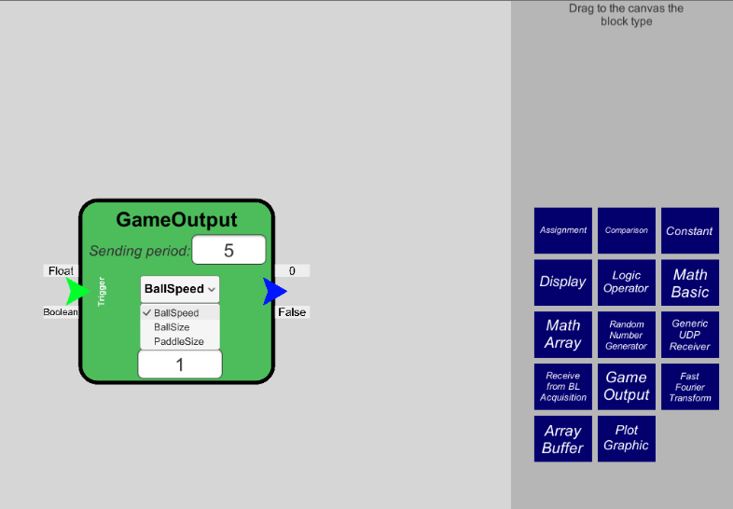
STEP 3: MAKE VISIBLE THE GAME VARIABLES IN THE BIOCYBERNETIC CONSOLE
Once you have a Build of the game with the Scripts described before, you will see the game variables in the BL Console (Game Output Block)
Use the Game Output Block to make the modifications of each of the game variables following the predefined rules.

Slide 7
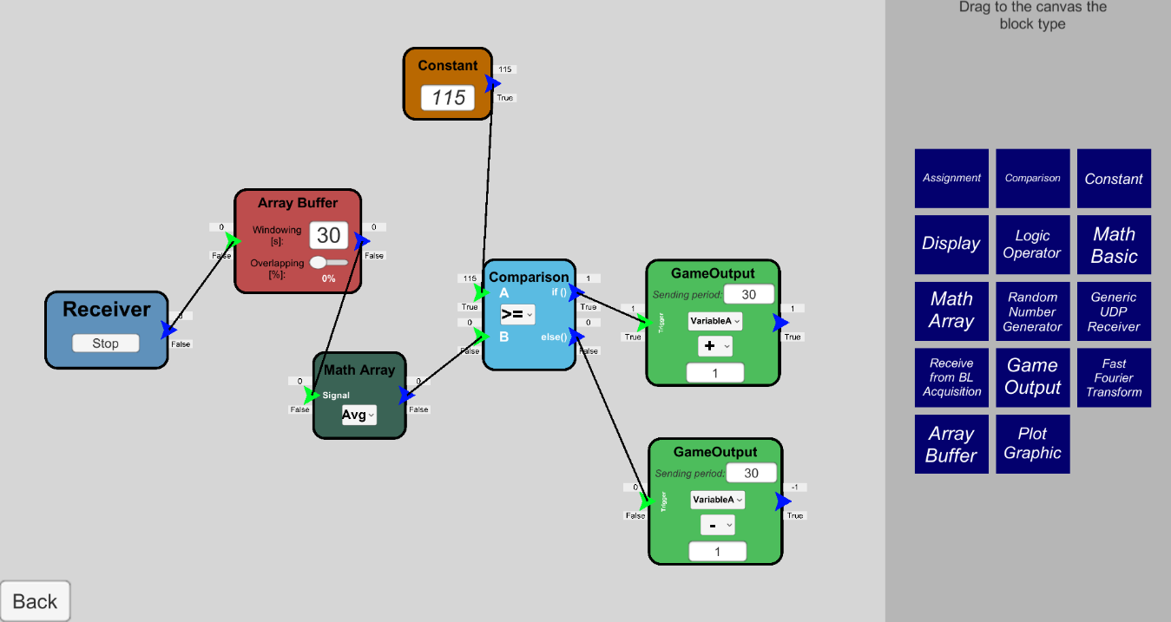
STEP 4: CREATE THE ADAPTIVE RULE AND ITERATE
Constant value (e.g. Target HR in this case)
Example of Adaptive Rule: here we modify the Variable A by increasing in one (1) unit
Makes arrays
If True, Add one (1) to the Variable A each 30 second
Receives HR data
(From Cardiac Panel)
Make computations with the arrays (e.g. mean, SD)
If False, Subtract one (1) to the Variable A each 30 second
Create your decision rule
Connect it to the Game Output
Establish a sending period
Choose the game variable
Choose the math operation (+,-,*,/)
Choose the variance number

Slide 8

REMEMBER: STILL UNDER DEVELOPMENT

Slide 9
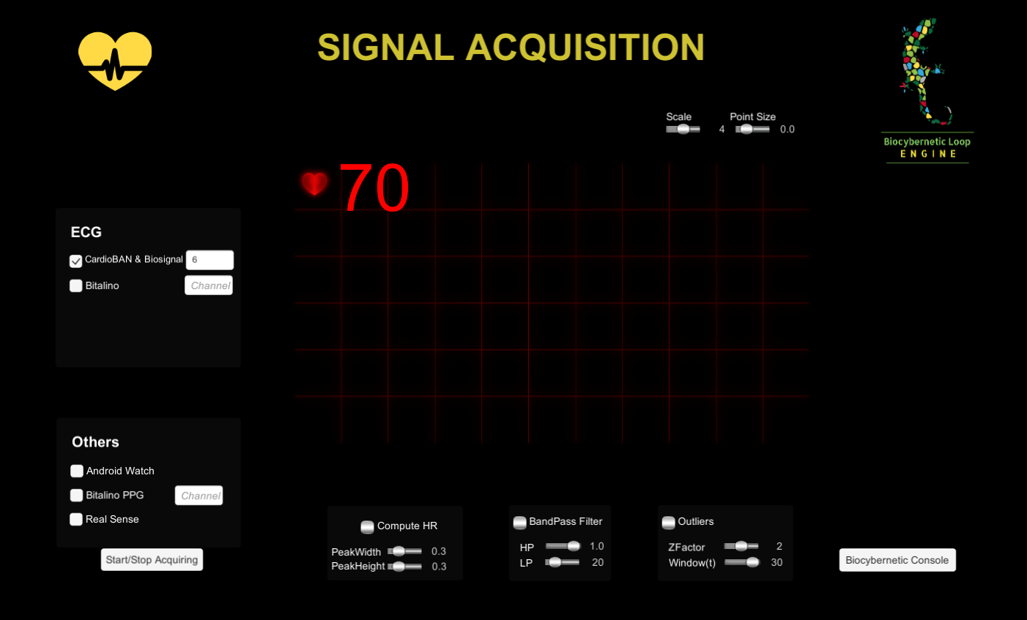
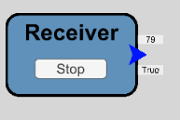
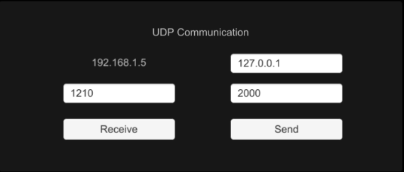
ADDITIONAL INFORMATION
Cardiac Panel
Read heart rate information from different sensors and receive it using the Receive from BL Acquisition block in the Biocybernetic Console.
Remember configure first the UDP!.
PhysioVR
Allows getting HR data from: a) android smartwatches and b) the PolarH7 sensor. (Link APK)
Real Sense (Camera)
Allows getting HR data directly from the camera.
CardioBan & Bioplux
Both connected through Bluetooth, use an UDP client (link) to send the raw ECG data. (Port 1204)
Bitalino (ECG or PPG)
Since it is connected through Bluetooth, it uses a COM which should be defined to get the raw signal.

Slide 10
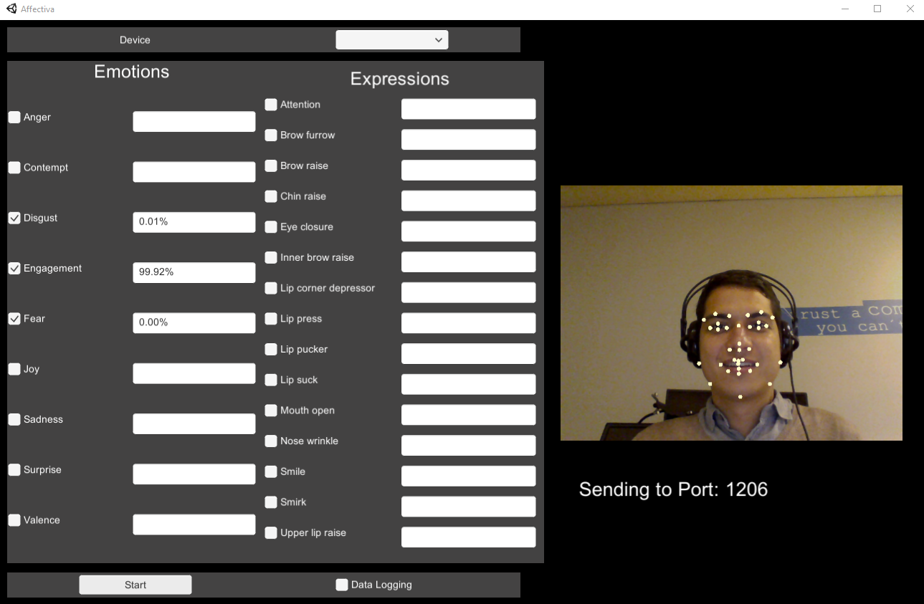
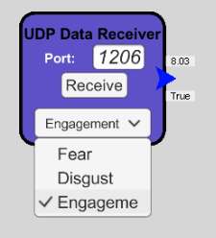
ADDITIONAL INFORMATION
EmoCam Panel
To receive the affective data from this panel, use the Generic UDP Receiver block of the Biocybernetic Console and receive data from the 1206 port.
WebCams
The Panel uses only webcams to register the emotions. Choose your webcam (device option) to start the visualization.
Emotions and Expressions
Choose between emotions and expressions to start the acquisition. You will see the tracked points in your face.
Data Logging
Check this option to record all the data (emotions and expressions) in a .CSV file.

Slide 11
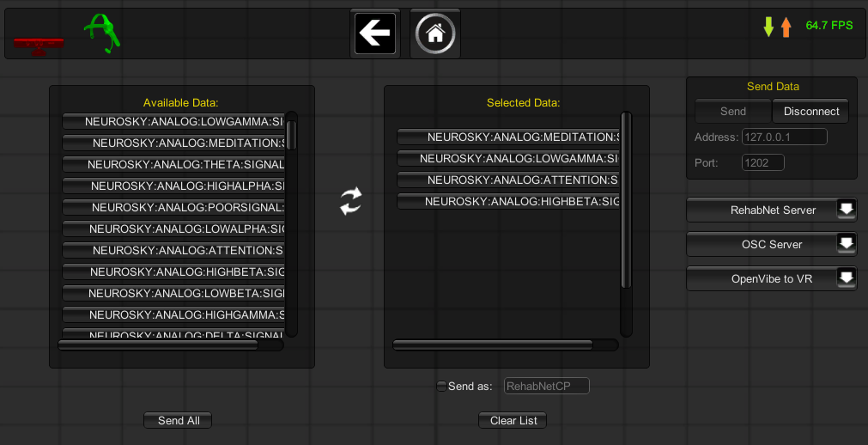
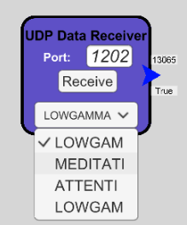
ADDITIONAL INFORMATION
Reh@Panel
Choose your sensor Choose the data you want to use
Receive the data using
the Generic UDP Data Receiver
in the Biocybernetic Console
1
2
3
Multiple sensors
The Reh@Panel includes Kinematic, Electrophysiological and Eye Tracking sensors
Endless options
Every sensor is able to stream different variables that will enrich your physiologically adaptive game
Many Receivers
Use as many Receivers as you desire (One to Many relations)

